Slide 1


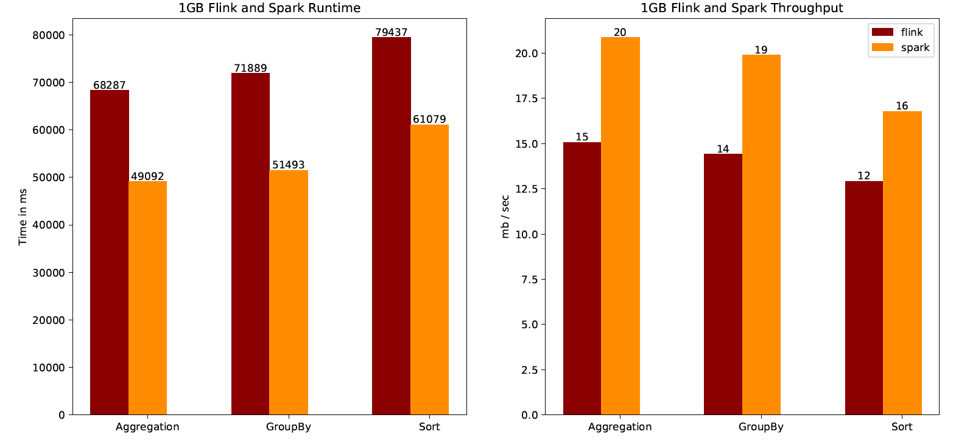
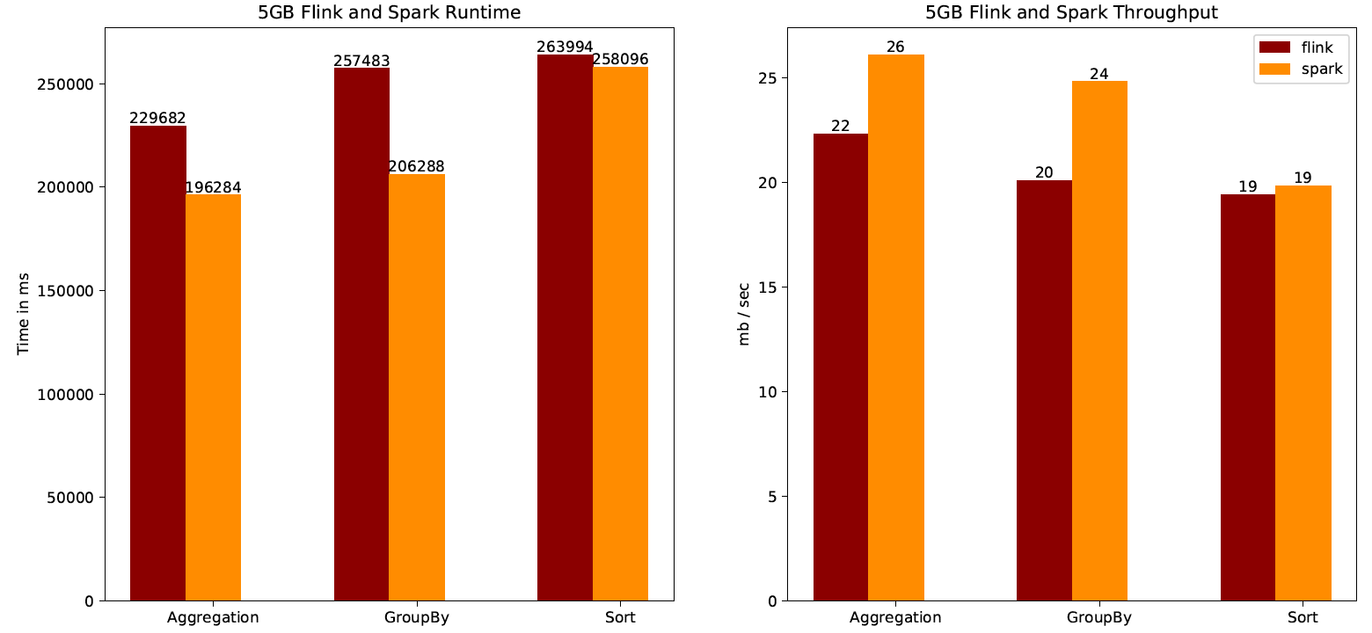
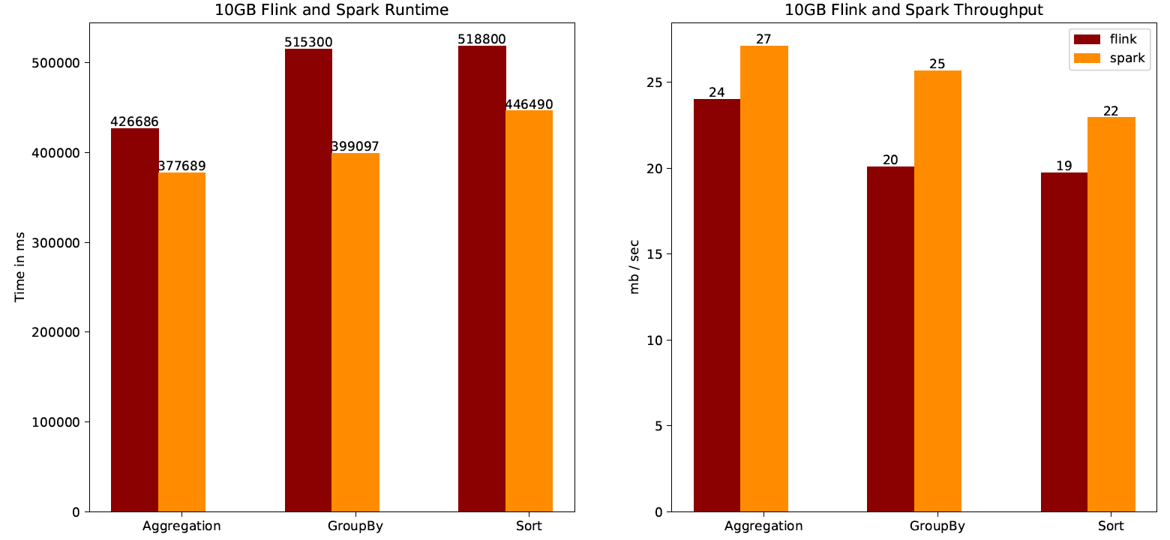
Enterprise Computing WS18/19
Parallel Batch Processing
VS
Experiment
Workloads & Metrics
Motivation:
Data:
typical book store
Amount of data size -> 1GB, 5GB, 10GB
Amount of records: 9m, 44m, 88m
Evaluating the throughput and runtime performance of spark and flink for different data sizes.
We are expecting spark to perform better with higher Throughput and lower runtime compared to flink.
Workloads for each metric and SUT:
Research Question:
GroupBy: genre, count per group
Sorting: number of pages (ascending)
Aggregation: price (max)
Measure throughput and runtime (for Group-By, Sorting, Aggregate) of Flink and Spark clusters on different input sizes and fixed structures (Book-Store) on fixed comparable systems and comparing the results.
Metrics:
Runtime
Throughput
Expectation
System Under Test (SUTs)
Expectation:
Benchmark approach:
client perspective
We are expecting Spark to perform better with higher throughput and lower runtime compared to Flink [1].
SUTs:
Flink 1.6.2
Spark 2.4.0
Cluster settings:
Provider: AWS
One master; Two slaves
EC2 type: m5.xlarge (4 vCore, 16 GiB memory)
us-east-1 region (N. Virginia)
Architecture
Interpretation of the Results
The Spark throughput for each job (GroupBy, Aggregation, Sorting) and for each data size (1GB, 5GB, 10GB) was higher.
The Spark runtime for each job (GroupBy, Aggregation, Sorting) and for each data size (1GB, 5GB, 10GB) was faster.
Conclusion
As expected, the Spark performance for the throughput and runtime was always better.
N
We conducted the experiments with small data sizes compared to real-world problems (>500GB). This was due to the AWS credit limitation (100$). Further experiments with bigger data sizes are needed to check if the Spark performance is also better in these cases.
[1] https://www.dbgroup.unimore.it/tesi/Magistrale/201516_Andrea_Spina_presentazione.pdf
Florian Muchow, Domenic Bosin, Muhammad Taha, Tristan Schneider

